Slide 1
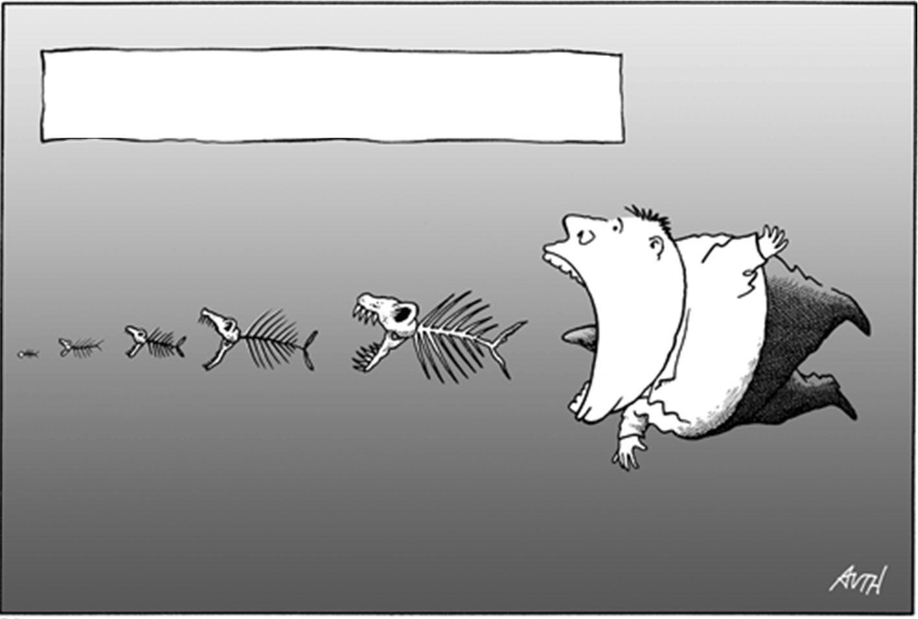
Targeting the causes of biodiversity loss:
Overexploitation through harvesting regulations

Slide 2
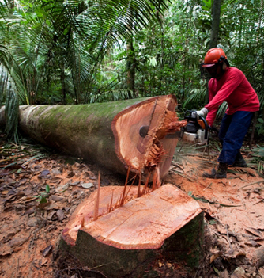

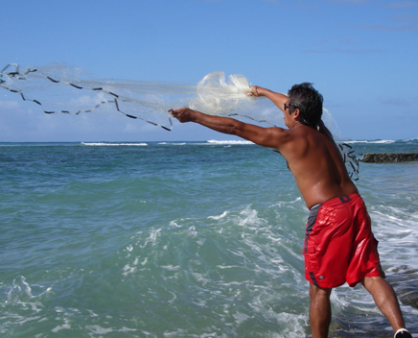
Targeting the causes of biodiversity loss: overharvesting and habitat loss
Education
Corruption
Inequity
Wealth
To many humans
Human needs
Household
Food
Energy
Protected areas
Regulation policies
Deforestation
Habitat modification
Over-harvesting

Slide 3
Regulation of harvesting means to implement levels of extraction that preserve the economic value of a stock while ensuring its sustainability
Requires scientific knowledge into the effects of harvesting on populations and ecosystems

Slide 4
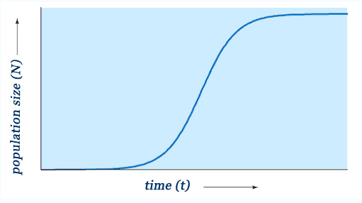
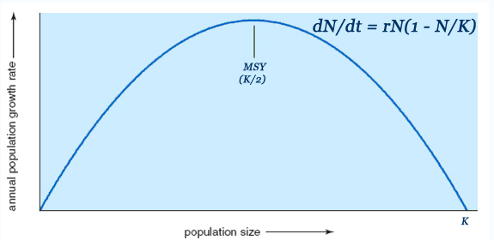
Scientific knowledge required for policy regulation:
1) the effects of harvesting on populations:
Annual growth rate
Maximum sustainable yield: the largest yield (or catch) that can be taken from a species' stock over an indefinite period
N _{(t+1)} = N_{(t)} + N_{(t)} * r
…this knowledge will determine the level of harvesting required to avoid population declines.

Slide 5
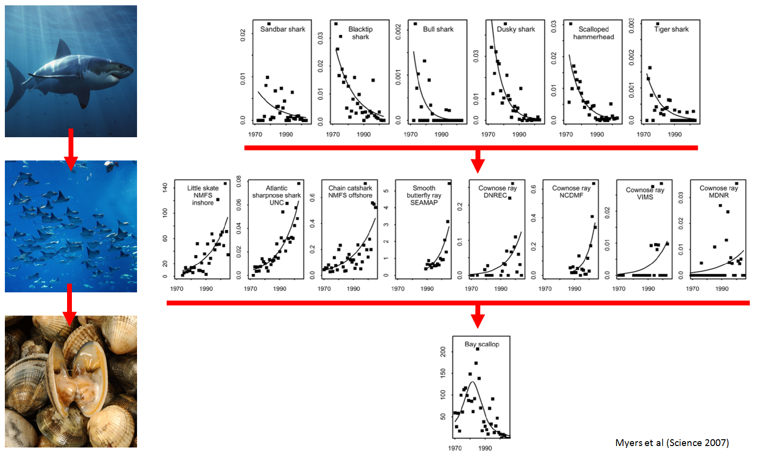
Scientific knowledge required for policy regulation:
2) the effects of harvesting on ecosystems
Populations are embedded within ecosystems

Slide 6
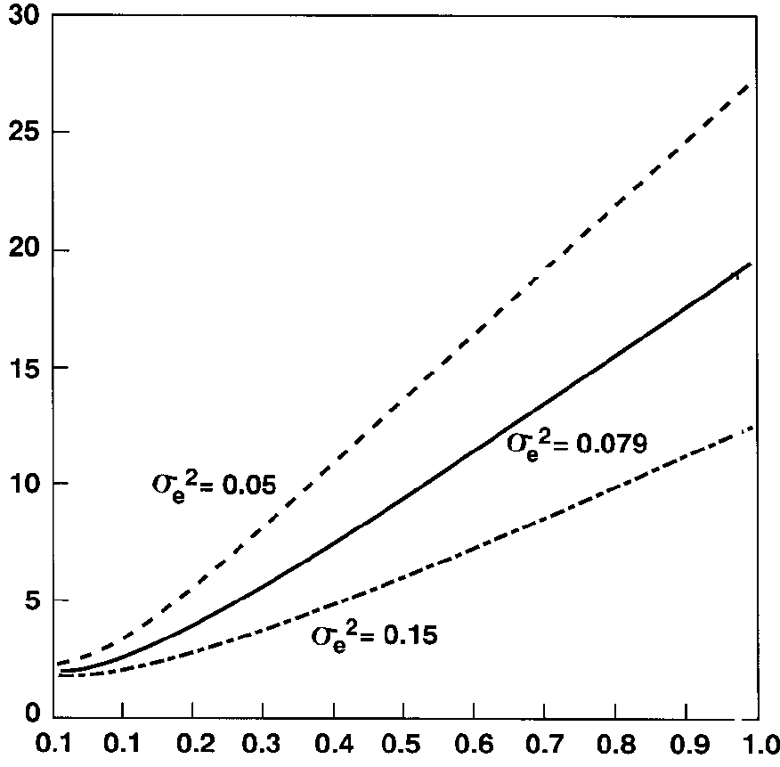
Scientific knowledge required for policy regulation:
3) the interactive effect between harvesting and the environment on populations
Environmental variance
Expected time to extinction
Population growth rate
Saether et al, American Naturalist 1998

Slide 7
Regulation of harvesting means to implement levels of extraction that preserve the economic value of a stock while ensuring its sustainability

Slide 8
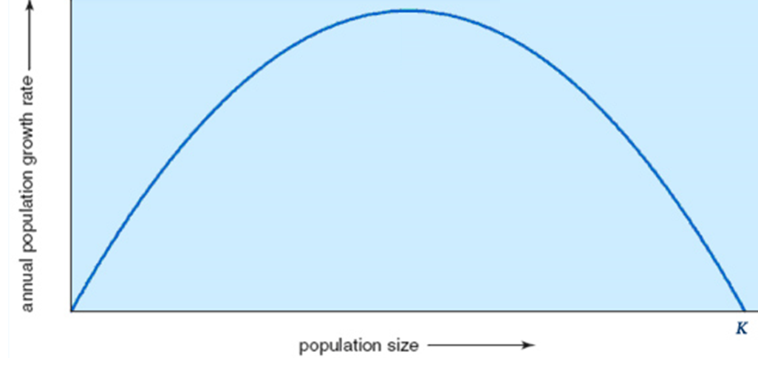
Scientific knowledge required for policy regulation:
4) To know the effects of harvesting…
…on the economy:
Maximum Economical Yield: a sustainable population size that yields the MOST economic profit
Zero surplus profit
MSY
“Surplus profit” in “open access systems” always leads to the addition of more harvesters, until the profit equals the cost, which unfortunately, it is a point in which populations decline
surplus profit
MEY
Cost
Fishing effort
…this knowledge is necessary to appeal harvesters over the use of smaller more profitable levels of harvest

Slide 9



Regulation of harvesting means to implement levels of extraction that preserve the economic value of a stock while ensuring its sustainability
Compliance
Enforcement
Information and data
REGULATIONS
Recommended levels of harvesting
Policy making

Slide 10
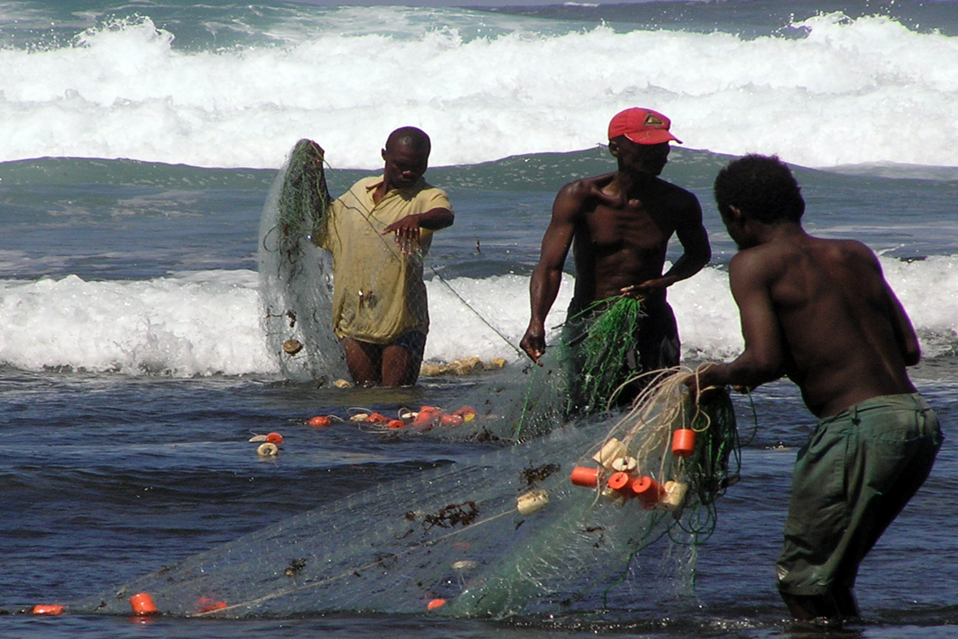
A case study on the global effectiveness of the policy regulations of fisheries
(Mora et al, PlosBiology 2009)

Slide 11
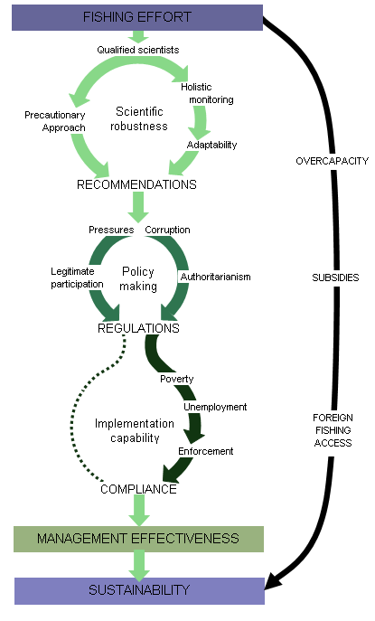
The Fishery Management Project
Participation
Corruption
Political pressures

Slide 12
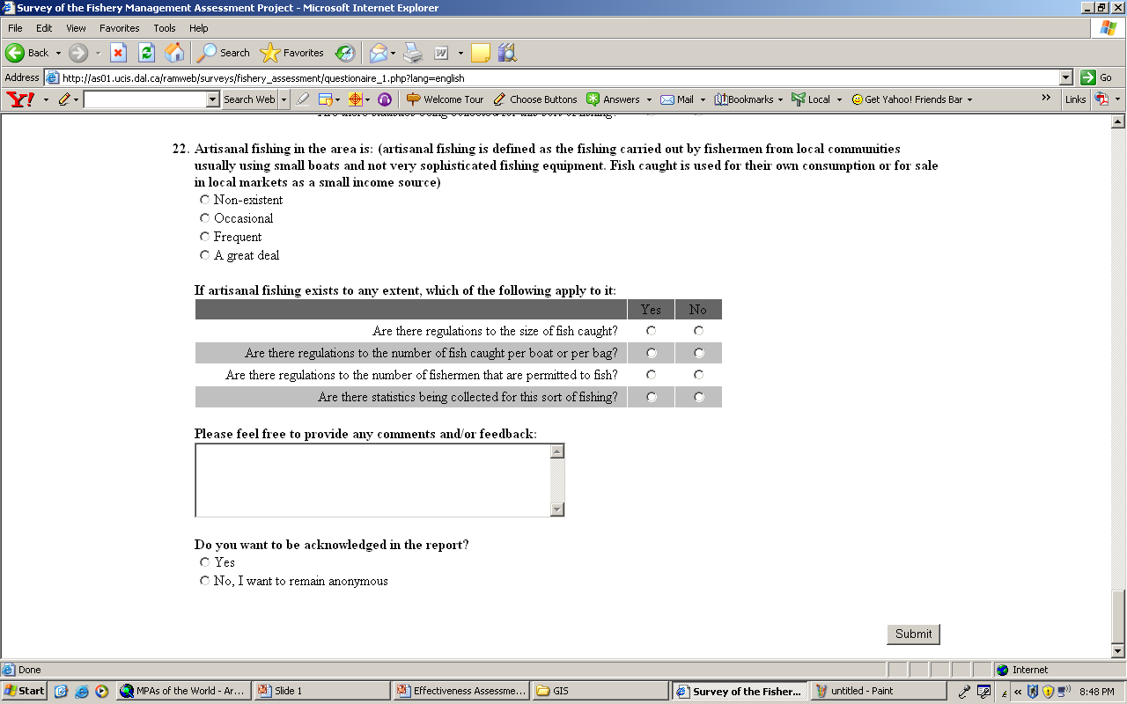
Fishery Management Assessment Project
1. Internet based survey
2. Enquire fishery experts: over 15000 experts worldwide contacted

Slide 13
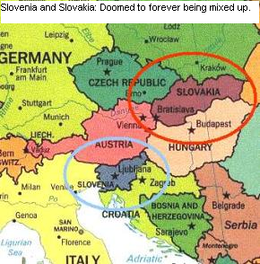
One needs to know geography in a project like this!

Slide 14
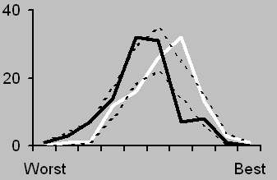
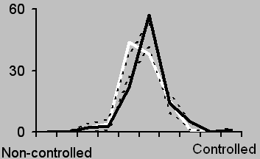
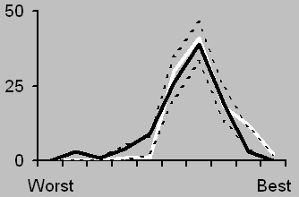
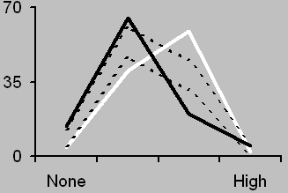
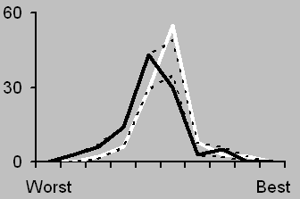
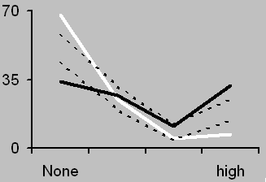
Scientific robustness
Fishing effort
Policy making transparency
Subsidies
Proportion of countries
Implementation capability
Access to foreign fishing
GDP by Income
Low
High

Slide 15
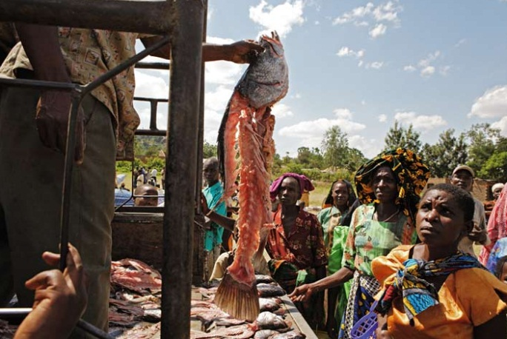
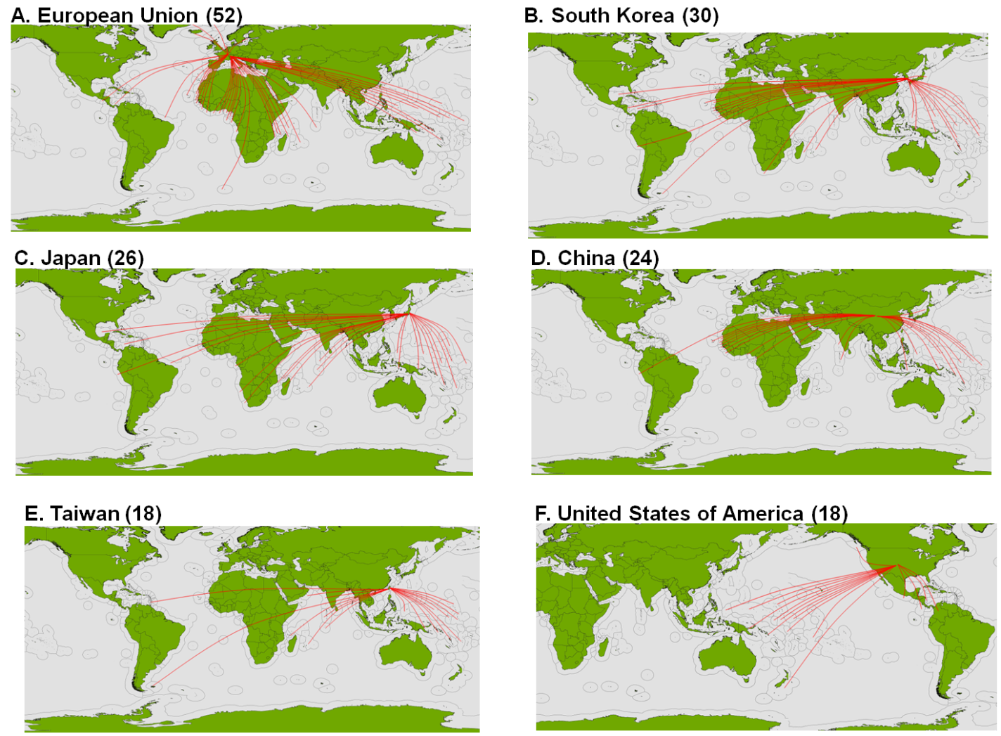
The unfairness of the global trade
International fishing agreements: the rich taking from the poor

Slide 16
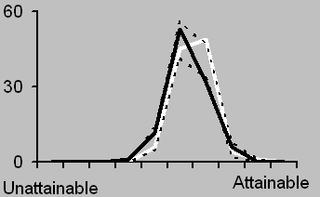
Scientific robustness
Fishing effort
Likely management sustainability
Policy making transparency
Subsidies
Proportion of countries
Implementation capability
Access to foreign fishing
GDP by Income
Low
High

Slide 17
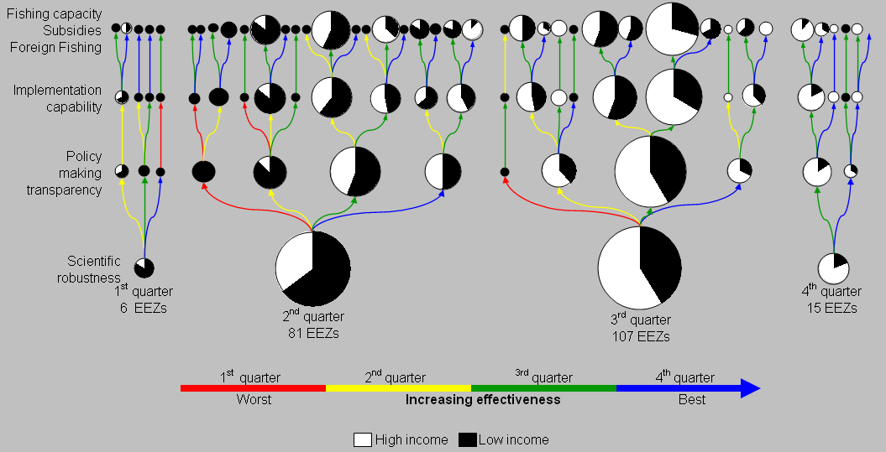
Effectiveness of the world’s fisheries management regimes
0%
0.9%
1.4%
7%

Slide 18
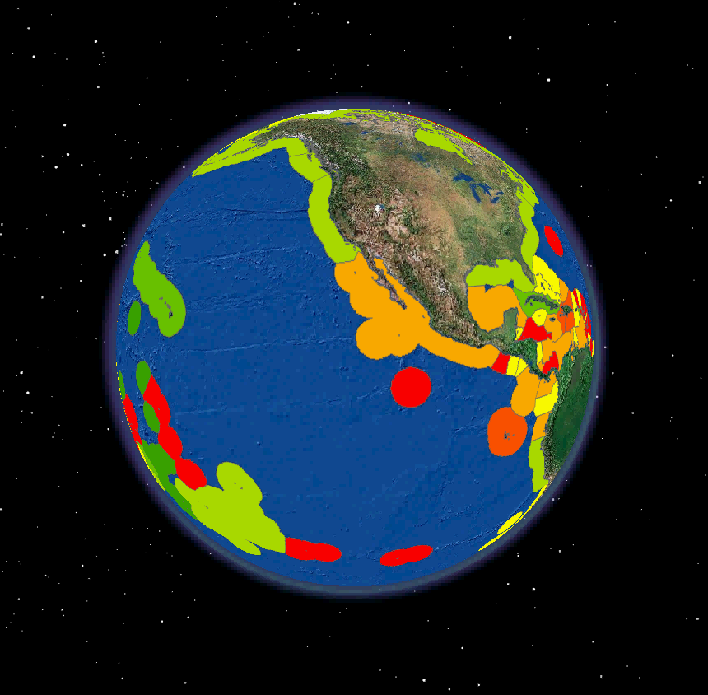
Average management effectiveness of the world’s fisheries
Best
average management score
Worse
Mora et al., PlosBiology 2009

Slide 19

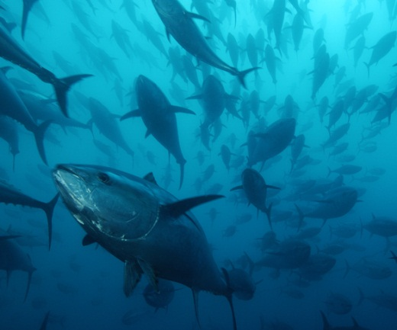
…Fishing regulation…
1.2% have additionally transparent policies
0.9% also have good enforcement
7% of the EEZs have good science
None is also unaffected by subsidies, foreign fishing and excess fishing capacity
Fisheries management
Preservation
of biodiversity
80% of the world’s fish stocks are overexploited, depleted or fully exploited (SOFIA 2006)

Slide 20
Targeting the causes of biodiversity loss: overharvesting and habitat loss
Education
Corruption
Will straggle to achieve their objectives of biodiversity protection
Inequity
Wealth
To many humans
Human needs
Household
Food
Energy
Protected areas
Regulation policies
Deforestation
Habitat modification
Over-harvesting

Slide 21
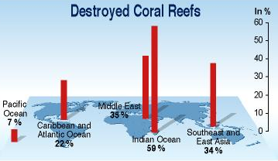
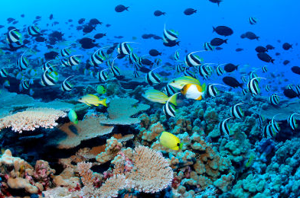
…Protected areas…
Management effectiveness
Biological effectiveness
0.1% are managed well enough to prevent poaching
Feasibility effectiveness
52% are to far apart to ensure connectivity
28% are not big enough to prevent mortality
81.3% of the world’s coral reefs remain unprotected
MPAs
Preservation
of biodiversity

